Slide 1
HIGH CLOUD AIRLINES CASE STUDY
Data Analysis & Dashboard Creation in Excel, Power BI, and Tableau
- GROUP 2

Slide 2
Our Team Members
Aditya
Anjana
Alina
Adarsh

Slide 3
INTRODUCTION
The airline industry is one of the most data-driven and transformative sectors in the global economy.
Efficient operations and data insights play a crucial role in enhancing passenger experience and optimizing resources.
Project Scope
This project analyzes High Cloud Airlines' flight data to uncover key trends.
The goal is to derive insights from airline operations, passenger load, and route performance.
Tools Used : Excel, Power Bi & Tableau. By leveraging Excel, Power BI, and Tableau, we aim to build interactive dashboards that provide a clear picture of airline performance, passenger preferences, and route optimization.

Slide 4
Objectives
The following objectives outline the key focus areas of this analysis:
Create various calculated fields (Year, Month, Quarter, etc.).
Analyze Load Factor Percentage (passenger load vs. available seats).
Identify Top Airlines, Routes, and Flight Trends.
Compare load factors on weekends vs. weekdays.
Group flights based on distance.
Build interactive dashboards with filters and KPIs.

Slide 5
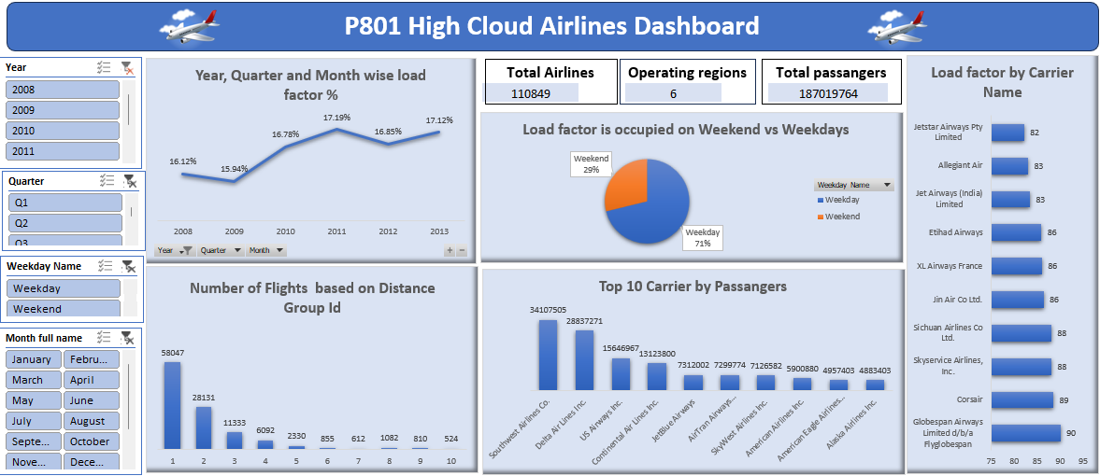
EXCEL PROJECT

Slide 6
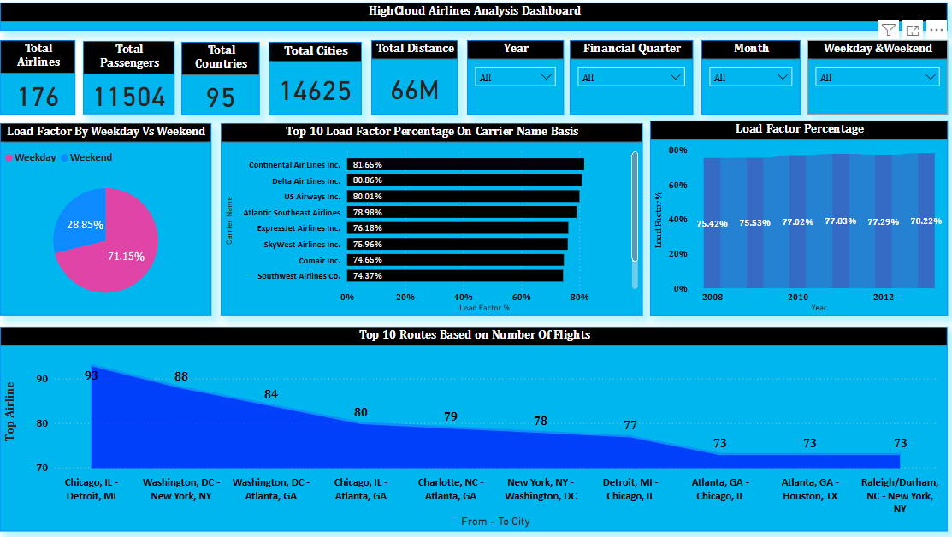
POWERBI PROJECT

Slide 7
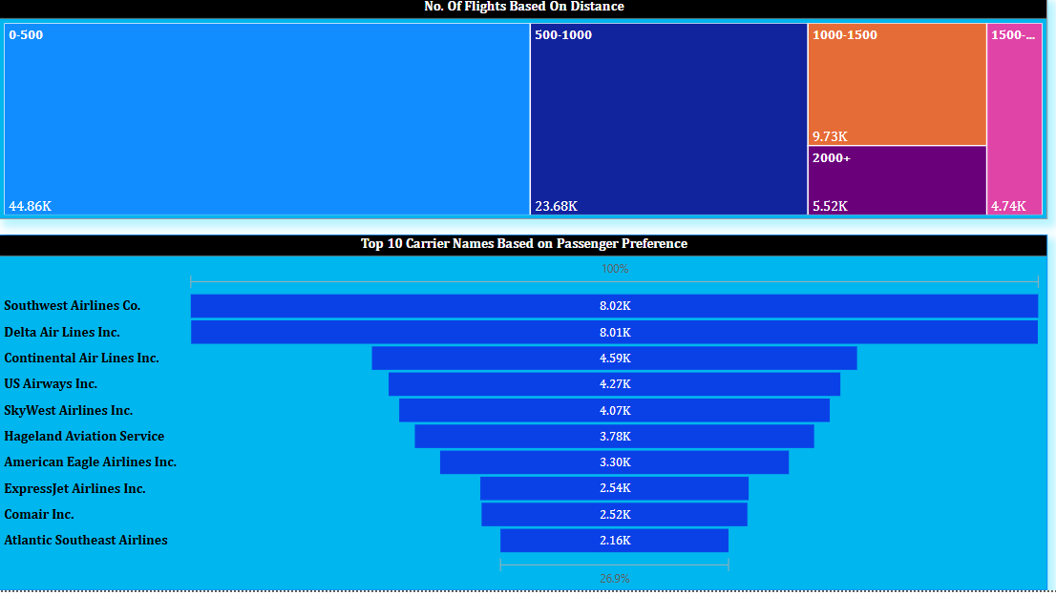

Slide 8
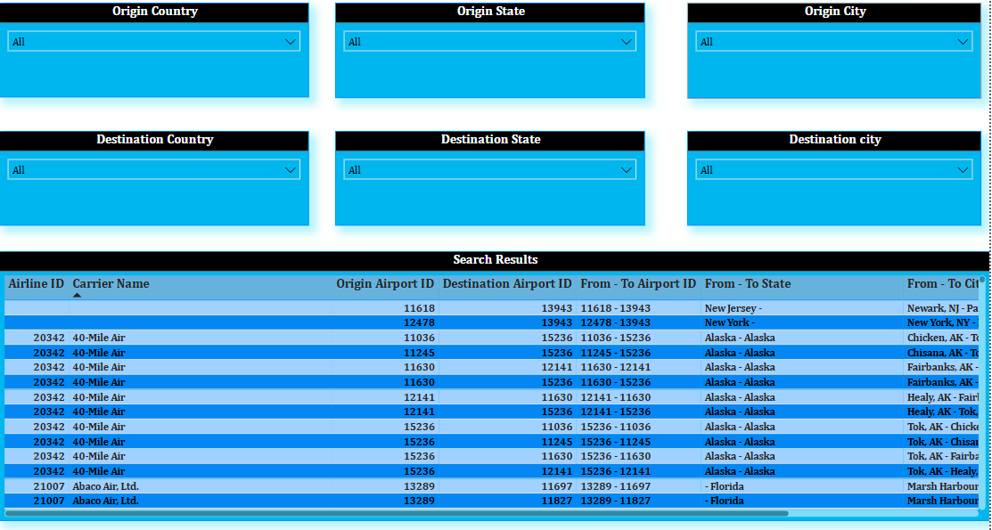

Slide 9
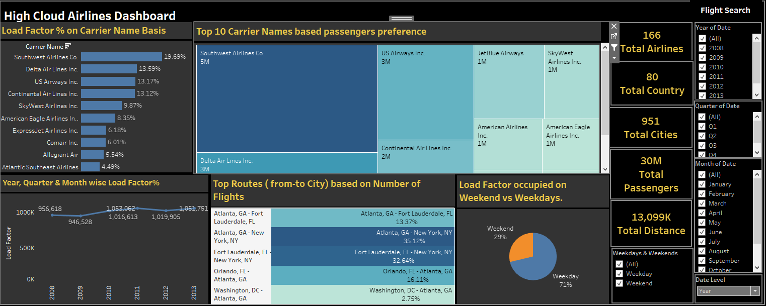
TABLEAU PROJECT

Slide 10
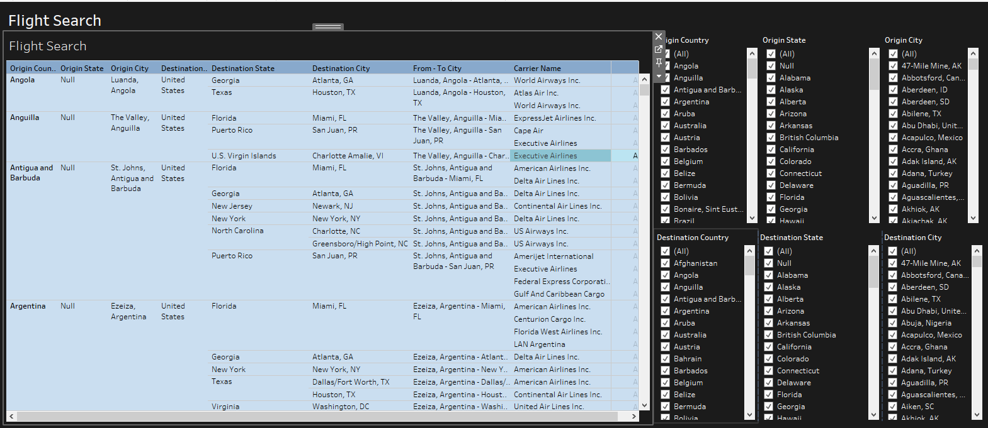

Slide 11
FINDINGS
176
Airlines
95
Countries
66115318
Distance
14625
Cities
11504
Passengers
The airline focused on catering to business travelers, who are less likely to travel on weekends. They are not designed to attract leisure travelers, that’s why weekend demand is remaining low.
Weekend
71.15%
Weekday
28.85%

Slide 12
Load factor Percentage on Yearly basis
Highest Percentage - 78.22% (2013)
Lowest Percentage - 75.42% (2008)
Top 10 carrier names based on passenger preference
Southwest Airlines dominates
Delta Airlines has remarkable Performance
Top 10 Load factor percentage on carrier name basis
Airlines contributing most passengers
Continental Airlines (81.65%)
Top 10 routes based on Number of Flights
Chicago-Detroit
Strong demand for this route
Number of flights based on distance
Short distance flights dominates
Strong demand for domestic travelers

Slide 13
THANK YOU

